Slide 1

Image Editor
Li Yulin
1409853G-I011-0074

Slide 2

1.
Introduction
2.
Comparison
3.
CONTENTS
Function
4.
conclusion

Slide 3

01
Introduction

Slide 4

Introduction
Python –v 3.6.3
UI –tkinter 8.6
1
2
4
3
Numba, used to
Improve the efficiency
of pre-process the image
Package:
Numpy, pillow, opencv 3.3.1

Slide 5
02
Comparison
Notes:
Abstract抽象

Slide 6
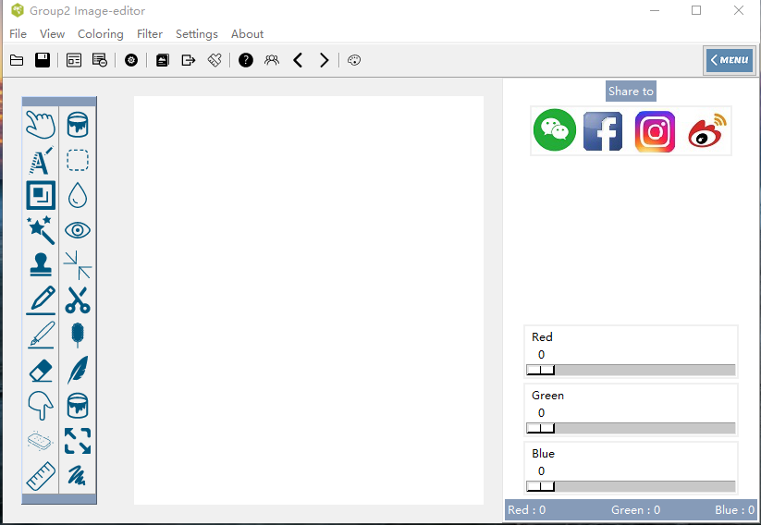
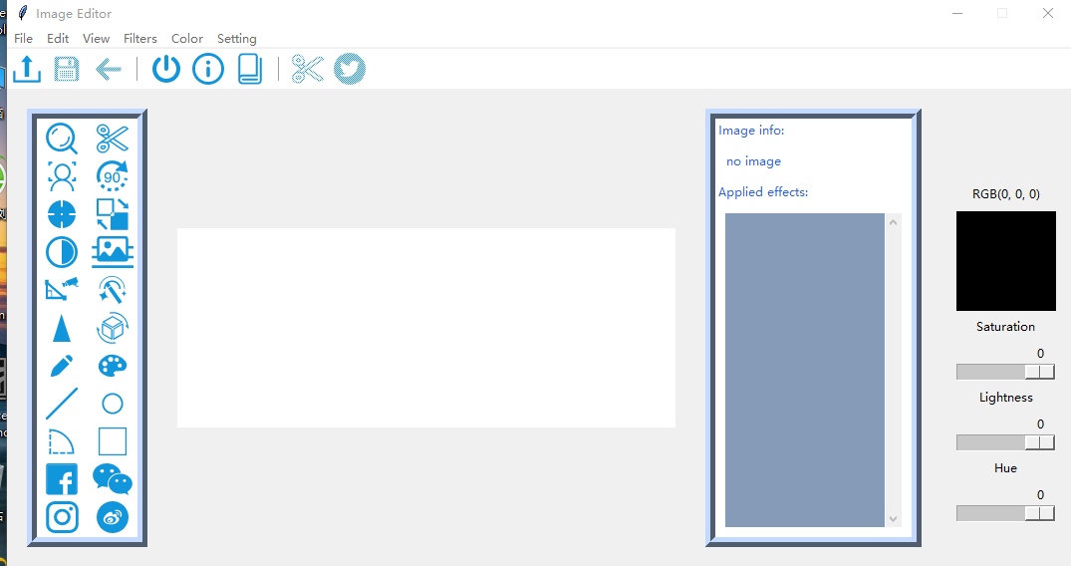
Comparison
Group Project
Individual Project
1
2
4
3

Slide 7
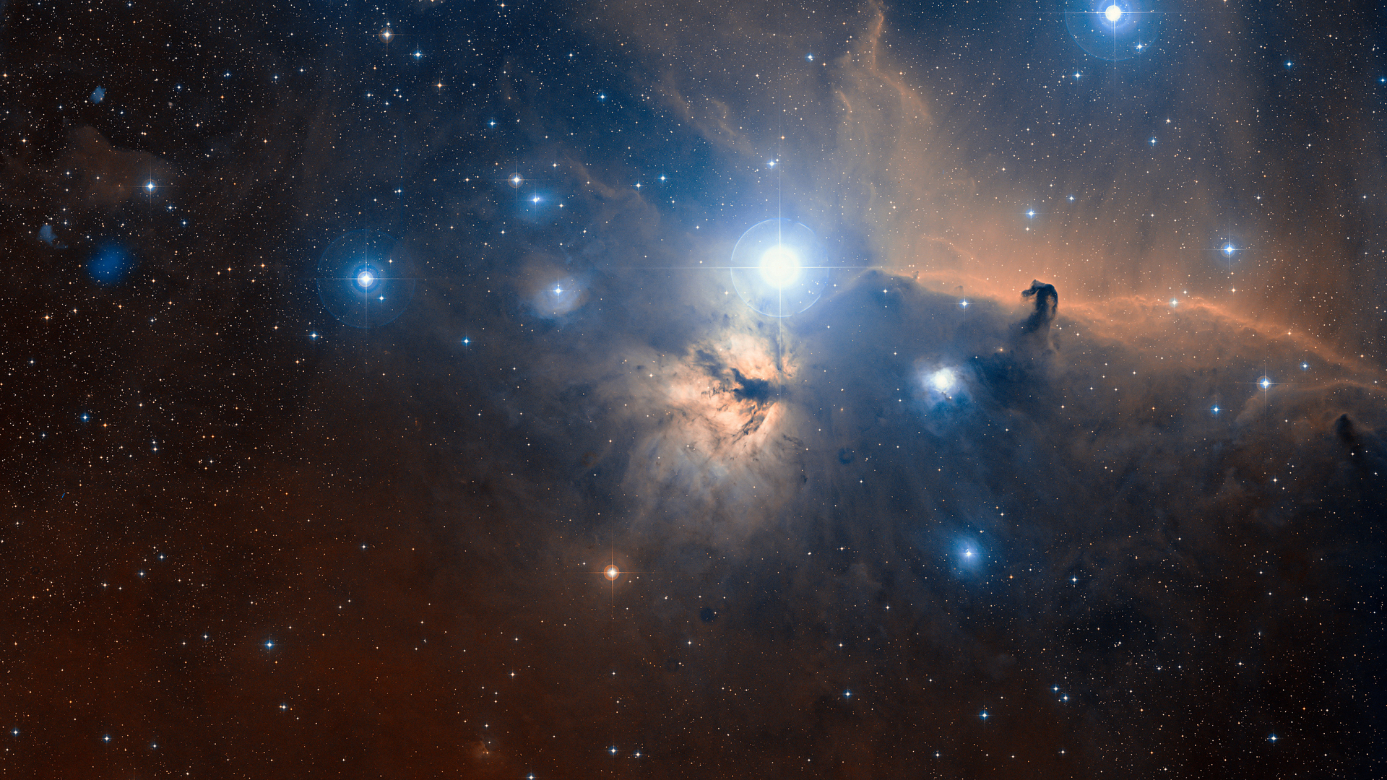
Comparison
Individual project
function
image process
interface
relation
Group project
function
Image process
interface
relation

Slide 8
03
function
Notes:
Abstract抽象

Slide 9


Function
Normal filter
Fundamental function
2 kinds of emboss Inverse
Motion blur Greyscale
3 kinds of sharpen lighten
Edge detection darken
Crop , Rotate, Zoom in/out
Always on top, open, save, undo,
Share.
Special function
Drawing tools
Human face recognition
Pen, change color,
Pattern like circle, line, rectangle
Sky filter

Slide 10
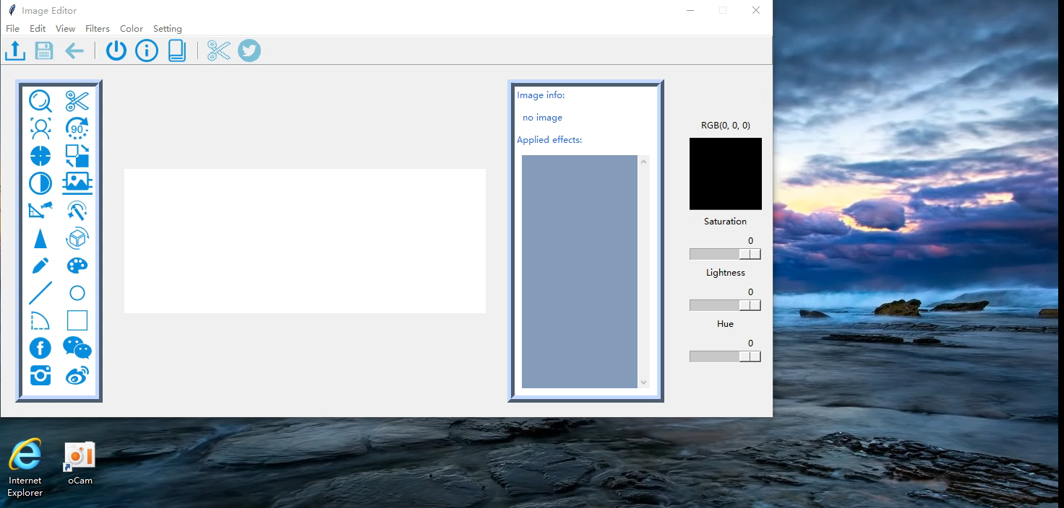

Slide 11
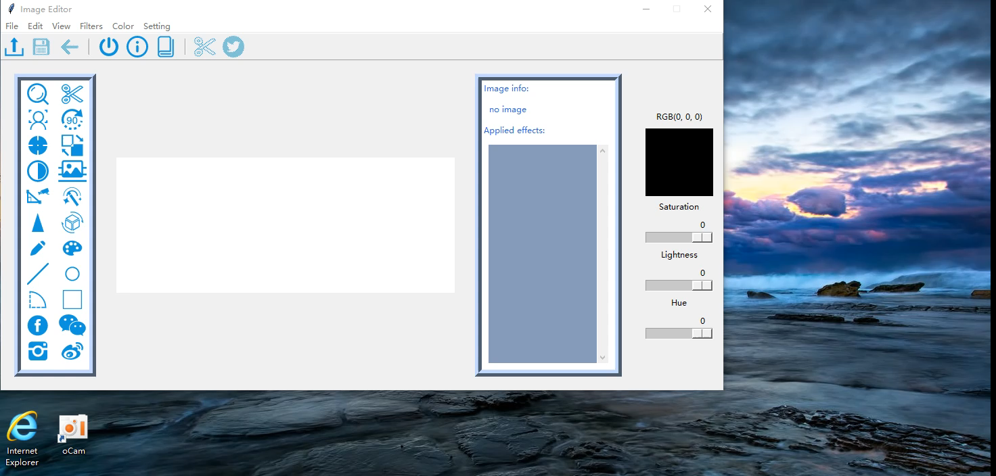

Slide 12
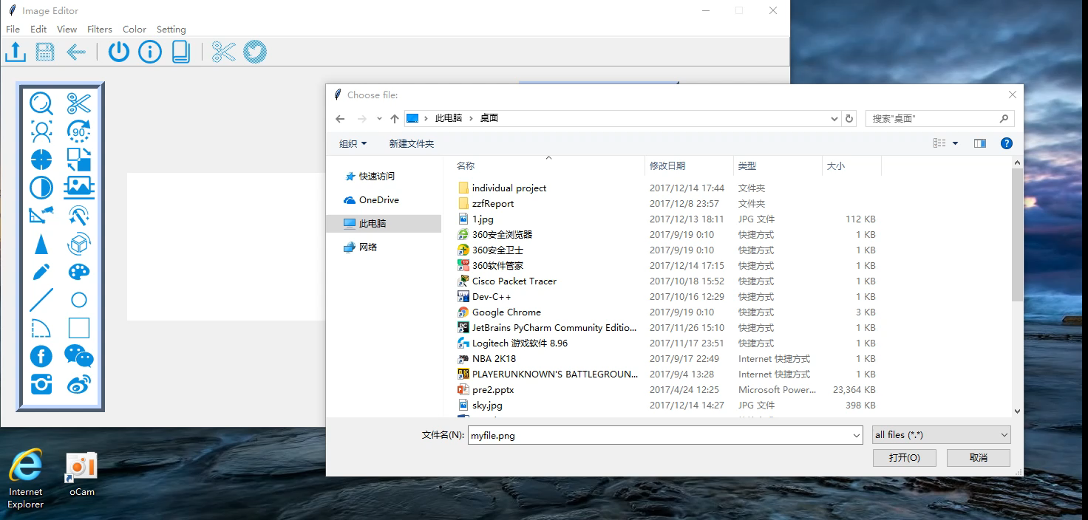

Slide 13
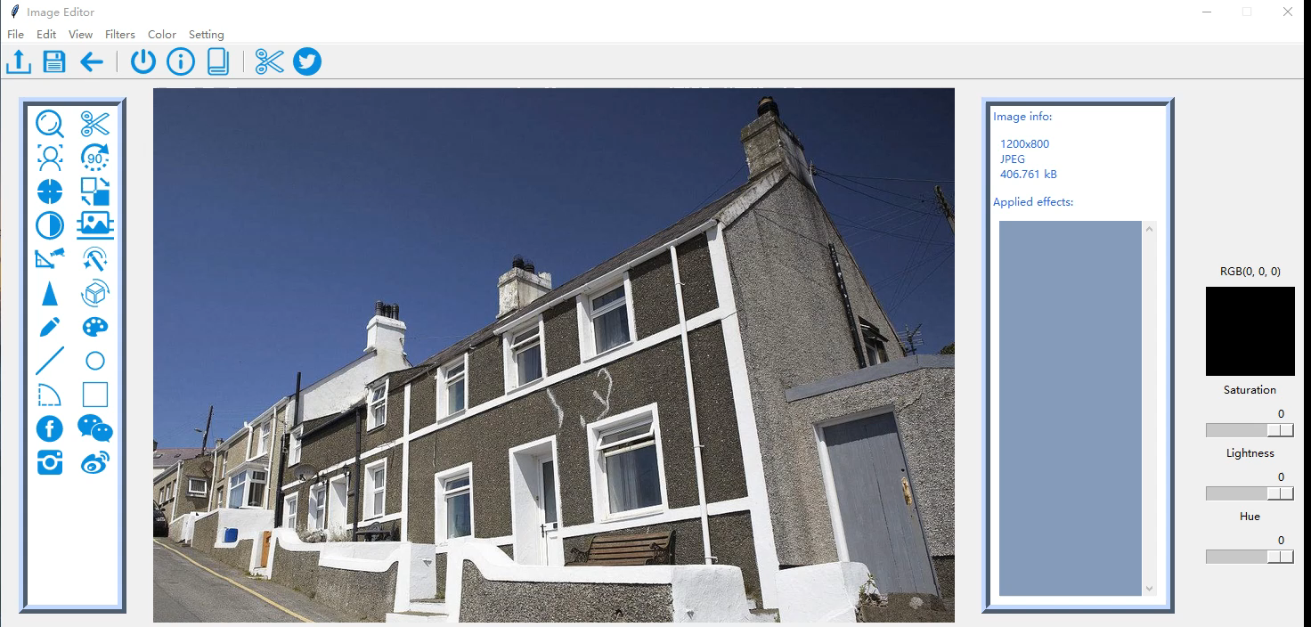

Slide 14
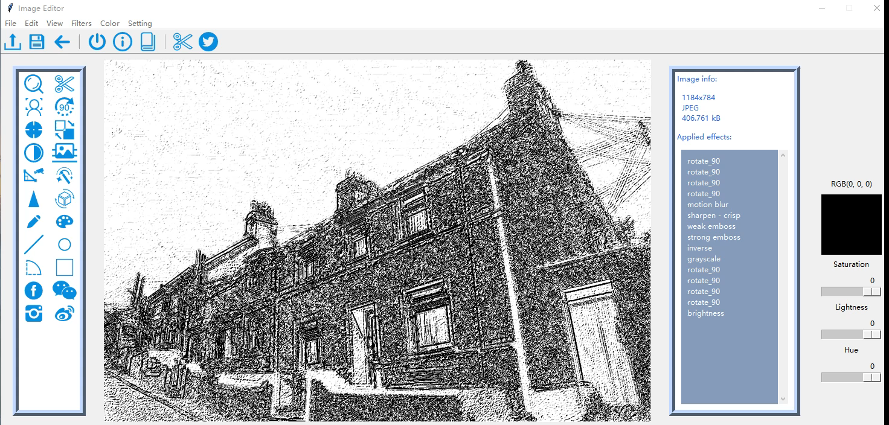

Slide 15
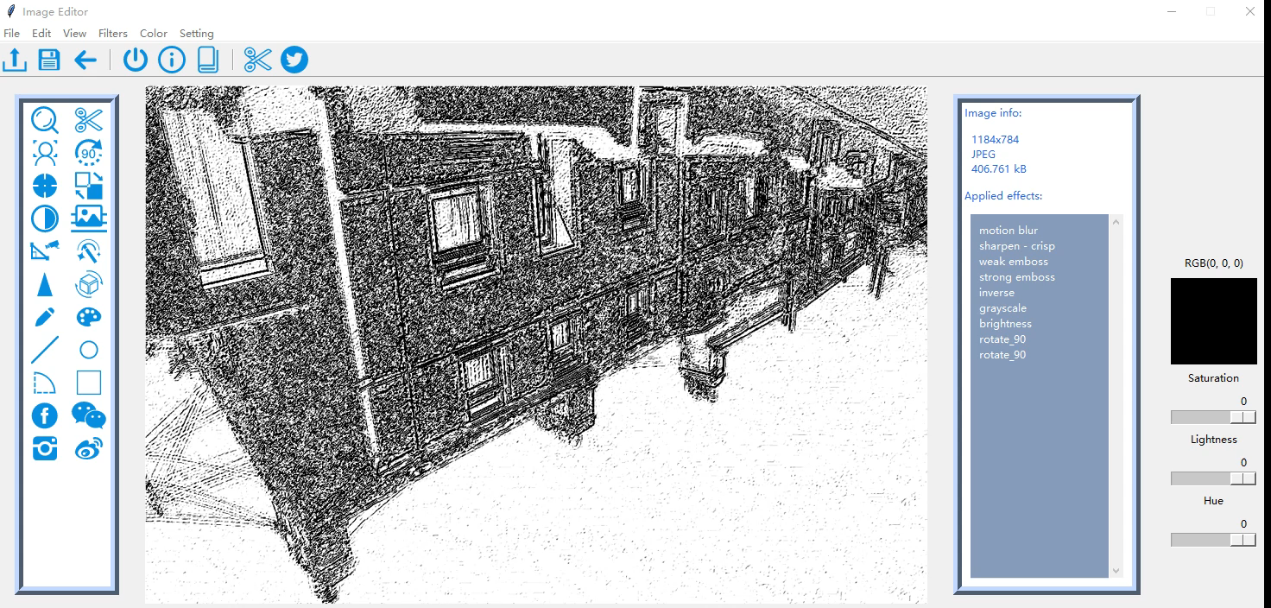

Slide 16

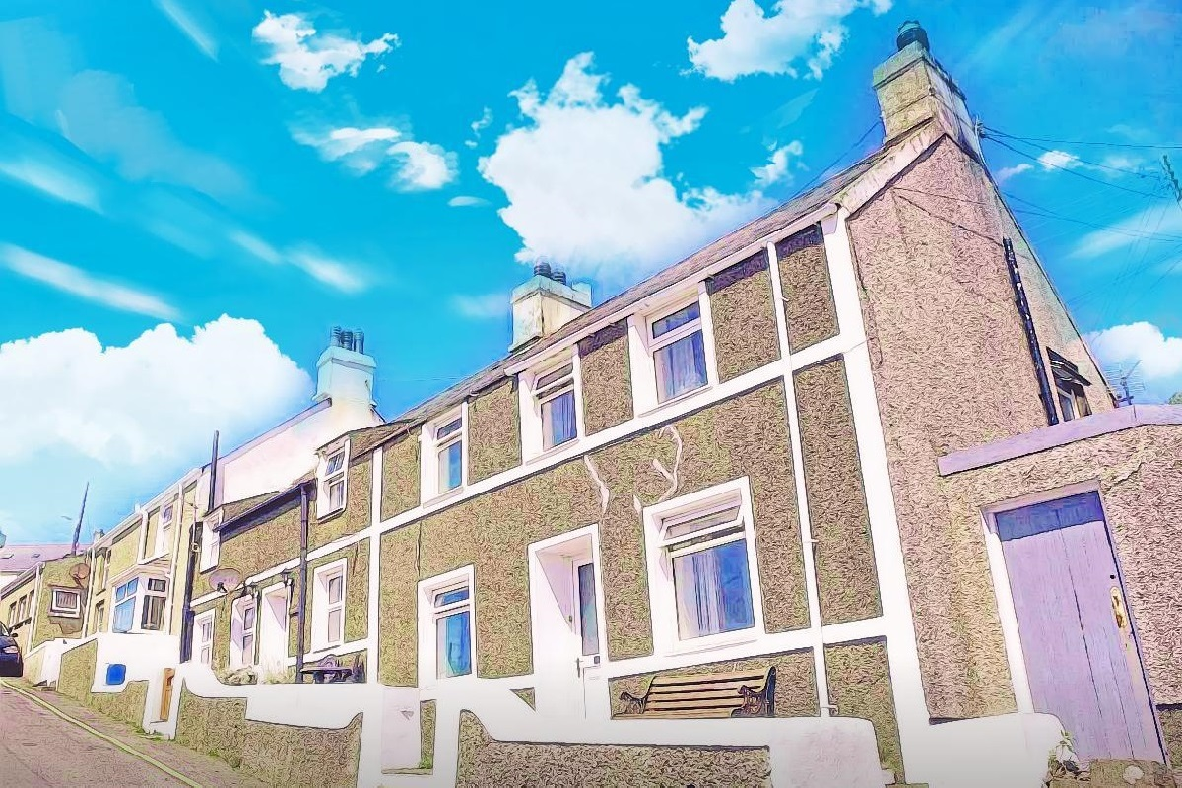
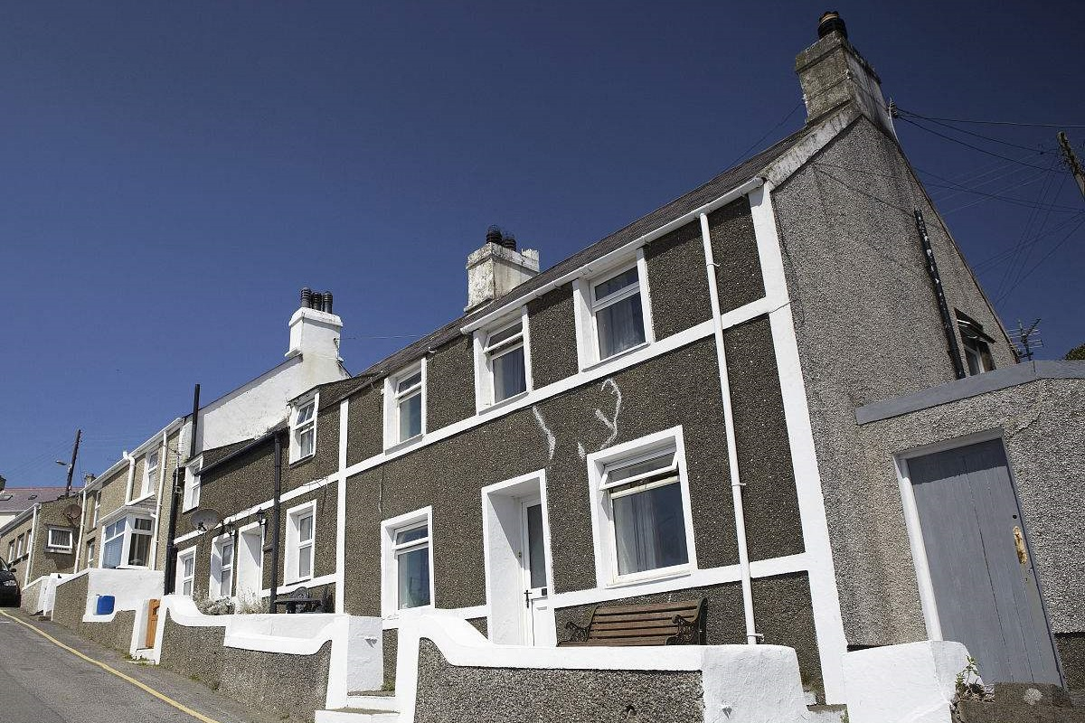
Sky filter
1
2
4
3
Notes:
首先是cvtColor，给原图从BGR转HSV去，然后把hsv的三个通道split一下
用Inrange分出我们需要的蓝色阈值区域。中值滤波一下消除杂点，让Mask看起来比较完整。跟着一个开操作，再滤波一下。其实这些都是我随便定的，目的就是让提取出的黑白Mask更完整一点，别尽是小杂点，我们只需要保证大致的准确就行。把检测区域存在mask里，做成一个黑白图片
seamlessClone 无缝融合，融合他和一个sky

Slide 17

Sky filter
1
2
4
3
Notes:
首先是cvtColor，给原图从BGR转HSV去，然后把hsv的三个通道split一下
用Inrange分出我们需要的蓝色阈值区域。中值滤波一下消除杂点，让Mask看起来比较完整。跟着一个开操作，再滤波一下。其实这些都是我随便定的，目的就是让提取出的黑白Mask更完整一点，别尽是小杂点，我们只需要保证大致的准确就行。把检测区域存在mask里，做成一个黑白图片
Get the edge and localization
seamlessClone 无缝融合，融合他和一个sky
Filter to change the color of the filter

Slide 18
04
Conclusion
Notes:
Abstract抽象

Slide 19
Challenge
The design of the Sky filter
The design of the interface
Some packages are my first time to use, and need to learn how to use it
Some strange debug errors in opencv 3.3.1

Slide 20
THANK YOU

Slide 21

Reference:
OpenCV change logs: http://code.opencv.org/projects/opencv/wiki/ChangeLog
OpenCV User Site: http://opencv.org/
Ch OpenCV: http://www.softintegration.com/products/thirdparty/opencv/
"Python Imaging Library". Secret Labs AB. Retrieved December 8, 2013.
"Details of package python-imaging in sid". packages.debian.org. Software in the Public Interest. Retrieved December 8, 2013.
"NumPy Sourceforge Files". Retrieved 2008-03-24.
"Numarray Homepage". Retrieved 2006-06-24.
"NumPy 1.5.0 Release Notes". Retrieved 2011-04-29.

